Slide 1
t-tests
Week 05 Jennifer Mankin

Slide 2
Looking Ahead (and Behind)
So far: Fundamental grammar
Amo, amas, amat…
Next up: Starting to converse!
. . .
This week: t-test
. . .
Coming up: Correlation, $χ^{2}$
Further ahead: The Linear Model
Take-Away Paper
You will have some data, which you must use to:
Ensure the data contains the necessary measures and values
Decide on and create a summary and visualisation
Perform an appropriate statistical test
. . .
You should be prepared to explain and justify your analytic decisions!
Use Your Resources!
Everything we ask you to do in the TAP, you will have practiced multiple times in tutorials, skills labs, and worksheets.
To prep or get help, come to Skills Labs and practicals!
Take-Away Paper
Technicalities:
Only available for 48 hours from Monday to Wednesday of Week 7
You can work on it as long as you want in the time available
Submit the rendered HTML file on Canvas
Read the TAP Information page on Canvas!
. . .
Important
THERE IS NO LATE SUBMISSION PERIOD!!!
Other Fun Stuff

Slide 3
Participants Needed!
Invitation to participate in final-year dissertation research
Hybrid teaching and disability support: rebrand.ly/hybrid_ds
ChatGPT and AI at University: rebrand.ly/gpt_uni
Awards
Education Award
Nominate a member of staff who has inspired or made a difference to you
Nominate for the Education Awards here!
SavioR Award
Nominate a fellow student on the course who has helped you with R
Nominate for the SavioR Award here!

Slide 4
Objectives
After this lecture you will understand:
The concepts behind comparing two means
Independent and paired samples t-tests
Where the t-statistic comes from
How to read histograms and means plots
How to interpret and report the results of t-tests
Comparing Two Means
Extremely common and fundamental testing paradigm
The Fundamental Question
Do people in one group score, perform, react, behave (etc.) differently than in another group?
. . .
Two types (for today!)
Independent: different entities/participants in each groups
Paired: same entities/participants in both groups
Very similar logic and interpretation, slightly different maths!
Taste the Rainbow: Synaesthesia (Redux)
People with synaesthesia have unusual sensory experiences
Experience colours for words, shapes for music, personalities for numbers, etc.

Slide 5
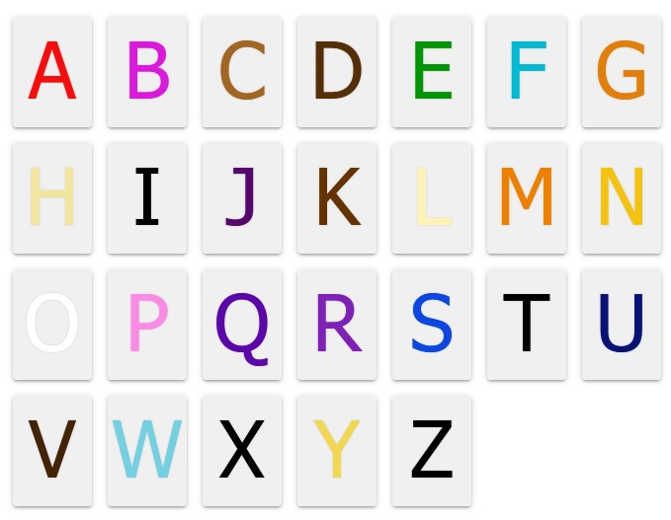
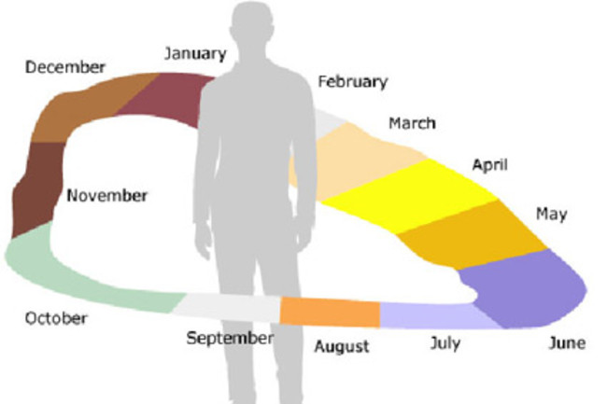

Slide 6
Grapheme-Colour Synaesthesia
Association between letters/words and particular colours
Tends to be consistent throughout life, beginning in childhood
So, synaesthetes might tend to notice language/spelling more often
Research Question
Do synaesthetes have a different cognitive style, compared to non-synaesthetes?
. . .
Conceptual hypothesis
Grapheme-colour synaesthetes have a more language-oriented cognitive style than non-synaesthetes
Data and Design: SCSQ
Mealor et al (2016): Sussex Cognitive Styles Questionnaire
Includes measures of imagery, language ability, and more
Example items: “I tend to notice if a word has the same letter repeated in its spelling”; “I enjoy learning new languages”
Validated on people with and without synaesthesia
. . .
Operational hypothesis
Synaesthetes will, on average, have a different score on the Language subscale of the SCSQ than non-synaesthetes
. . .
What is the null hypothesis?
Summary of Design
Research Question
Do synaesthetes have a different cognitive style, compared to non-synaesthetes?
. . .
Conceptual hypothesis
Grapheme-colour synaesthetes have a more language-oriented cognitive style than non-synaesthetes
. . .

Slide 7
Operational hypothesis
Grapheme-colour synaesthetes will have, on average, a different score on the Language subscale of the SCSQ than non-synaesthetes
Null hypothesis
Grapheme-colour synaesthetes will have, on average, the same score on the Language subscale of the SCSQ as non-synaesthetes

Slide 8
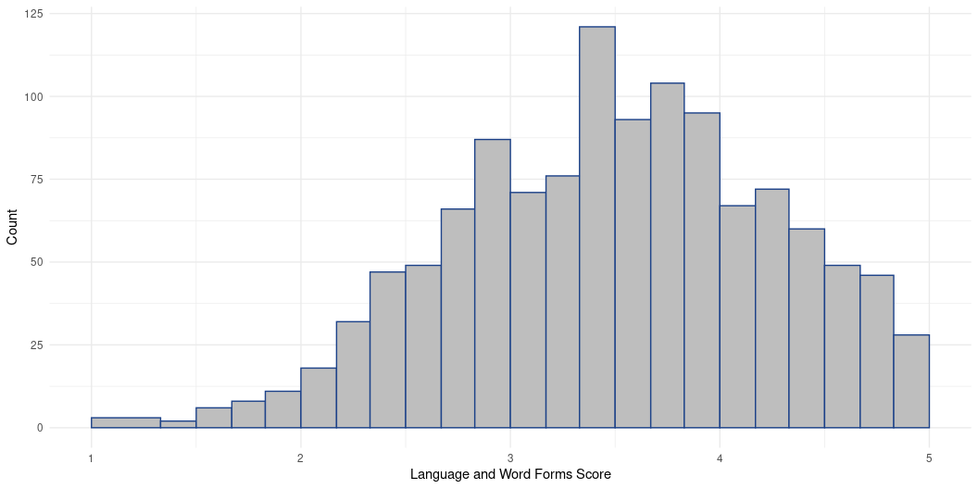
Having a Look
Let’s begin with all scores on the Language subscale together

Slide 9
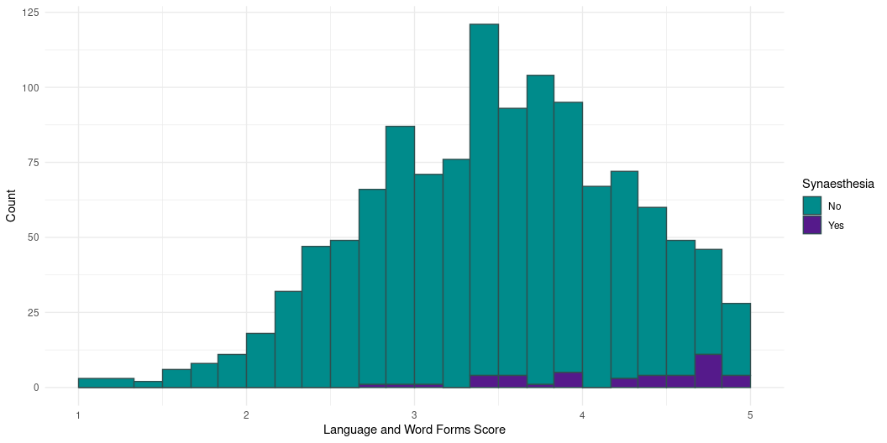
Having a Look

Slide 10

Having a Look

Slide 11
Sorted!
The mean Language score for synaesthetes is higher than for non-synaesthetes
Are we done?
. . .
Of course not 😁
How different are these mean scores, accounting for how much scores vary?
How strong is the signal (the difference in means)…
Compared to the noise (the variation in mean differences)?
Steps of the Analysis
Calculate the test statistic (signal-to-noise ratio)
. . .
Compare that test statistic to its distribution under the null hypothesis
. . .
Obtain the probability p of encountering a test statistic of the size we have, or larger, assuming the null hypothesis is true

Slide 12
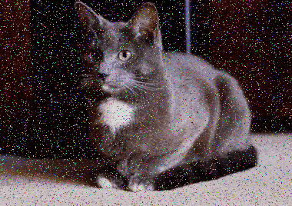
Vocabulary: Ratio
A number that captures the relative size of two quantities, expressed as how many times bigger the first quantity is than the second. Calculated as the first divided by the second.
e.g., if the seagull-to-human ratio in Brighton is 3, then there are 3 seagulls for every 1 human, or 3 times as many seagulls as humans.

Slide 13
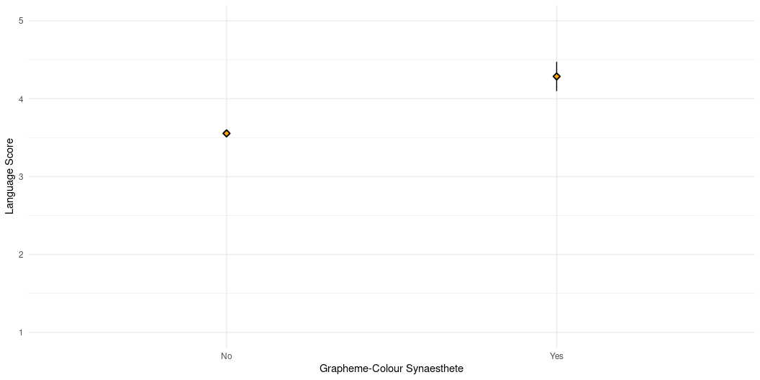
Calculating the Test Statistic: The Signal
The “signal” is the relationship of interest
The variation in scores explained by group membership
Here: the relationship between being a synaesthete (or not) and Language score
. . .
Calculate the mean of each group
Subtract one mean from the other
The size of the difference in means is the signal
Having a Closer Look

Slide 14
Calculating the Signal
Let’s get some numbers to work with 🤓
Mean in synaesthete group: 4.29
Mean in nonsynaesthete group: 3.55
. . .
Difference in the means (the “signal”) = 4.29 - 3.55 = 0.74
. . .
Is this a big difference, compared to how different we might expect any two sample means to be from the same population?
Calculating the Test Statistic: The Noise
The “noise” is the error, the variation NOT explained by group membership
The differences in means have a sampling distribution!
Exactly analogous to the sampling distribution of the mean
. . .
So, the “noise” is the standard error of the difference in means between synaesthetes and non-synaesthetes
Estimate of how different we expect any two sample means to be from the same population
Side Note: Why “from the same population”?
Remember: the null hypothesis was that on average, there’s no difference between synaesthetes and non-synaesthetes on Language score
Basically: group membership doesn’t matter
. . .

Slide 15
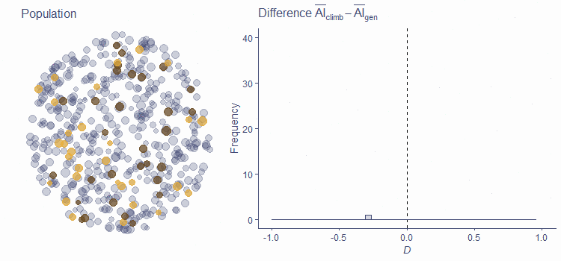
We’re sampling from the same population of scores; synaesthesia is irrelevant
Very small differences in means quite likely
Very large differences in means quite unlikely

Slide 16
Calculating the Noise
The maths get a bit more complicated here!
We can derive the standard error of the difference in means from s and N…
. . .

Slide 17
$$s_{p}^{2}=\frac{\left(n_{1}−1\right)s_{1}^{2}+\left(n_{2}−1\right)s_{2}^{2}}{n_{1}+n_{2}−2}$$
$$\hat{SE_{M_{diff}}}=\sqrt{\frac{s_{p}^{2}}{n_{1}}+\frac{s_{p}^{2}}{n_{2}}}$$
syn_lang_syn <- syn_data |> dplyr::filter(syn_graph_col == "Yes") |> dplyr::pull(scsq_language) syn_lang_nonsyn <- syn_data |> dplyr::filter(syn_graph_col == "No") |> dplyr::pull(scsq_language) n_syn <- length(syn_lang_syn) n_nonsyn <- length(syn_lang_nonsyn) sd_syn <- sd(syn_lang_syn, na.rm = TRUE) sd_nonsyn <- sd(syn_lang_nonsyn, na.rm = TRUE) sd_pooled <- (((n_syn - 1)*(sd_syn^2)) + ((n_nonsyn - 1)*(sd_nonsyn^2)))/(n_syn + n_nonsyn + 2) mdiff_se <- sqrt((sd_pooled/n_syn) + (sd_pooled/n_nonsyn)) mdiff_se
[1] 0.1151723

Slide 18
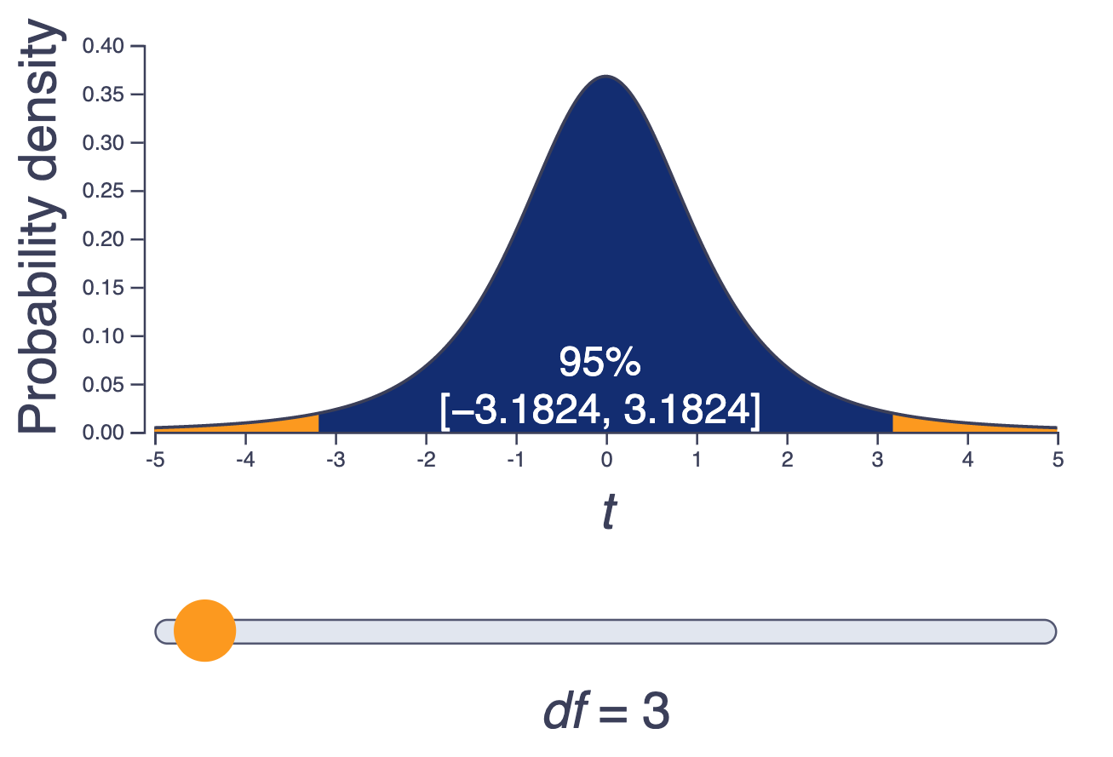
Steps of the Analysis, Redux
Calculate the (standardised) difference between mean scores
Divide the signal (difference in means) = 0.74…
By the noise (standard error of the difference in means) = 0.12
. . .
This is our “test statistic” t, or signal-to-noise ratio
$$t=\frac{signal}{noise}=\frac{M_{diff}}{SE_{M_{diff}}}=\frac{0.74}{0.12}=6.43$$
. . .
Vocabulary: Test Statistic
A number that captures the relationship or comparison of interest. Common examples include t, r, $χ^{2}$, F. Typically has the general form:
$$\frac{\text{estimate of the relationship or difference}}{\text{estimate of the variation in estimates}} \text{or} \frac{signal}{noise}$$
We Did It!!
…Or did we?
. . .
What does this number mean? How (un)likely is it?
. . .
Steps of the Analysis, Redux
Compare the test statistic to its distribution under the null hypothesis
Obtain the probability p of encountering a test statistic of the size we have, or larger, if the null hypothesis is true
What’s the Point?
The test statistic t is the difference in group means divided by their standard error
So, t represents how big the signal is compared to the noise
. . .
Each test statistic has its own known distribution under the null hypothesis
Known probability of encountering any given test statistic under the null hypothesis
Including t, which is (surprise) t-distributed
. . .
Important
Larger values of t are increasingly unlikely under the null hypothesis (ie. when the “signal” is, in reality, 0)
What’s the Point?

Slide 19
Interactive visualisation
Would You Like Some t?
Naturally, t is t-distributed (here, with N1 + N2 - 2 degrees of freedom)
What can we conclude, given an $α$ level of .05?
. . .

Slide 20
If p > .05
Our results are likely to occur under the null hypothesis
We have no evidence that the null hypothesis is not true
Conclusion: RETAIN THE NULL
If p < .05
Our results are unlikely to occur under the null hypothesis
It may in fact be the case that the null hypothesis is not true
Conclusion: REJECT THE NULL

Slide 21
Side Note: It’s Exactly Backwards
The word “significant” implies
Big
Noticeable
Having a large impact
So we might expect that “significant” means bigger than 0.05
. . .
It is the exact opposite of that!
Statistical significance expresses surprisingness - the probability of unlikely events
So, small p-values are “significant”, not large ones
That’s the t
After all of that work…R can do it for us instantaneously!
Two Sample t-test data: scsq_language by syn_graph_col t = -6.3394, df = 1209, p-value = 3.25e-10 alternative hypothesis: true difference in means between group No and group Yes is not equal to 0 95 percent confidence interval: -0.9576637 -0.5049972 sample estimates: mean in group No mean in group Yes 3.554949 4.286279
What do you think?
What should we conclude?
Would You Like Some t?
Two Sample t-test data: scsq_language by syn_graph_col t = -6.3394, df = 1209, p-value = 3.25e-10 alternative hypothesis: true difference in means between group No and group Yes is not equal to 0 95 percent confidence interval: -0.9576637 -0.5049972 sample estimates: mean in group No mean in group Yes 3.554949 4.286279
Reporting the Results
“On average, grapheme-colour synaesthetes scored higher on the Language subscale of the SCSQ (M = 4.29, SD = 0.61) than non-synaesthetes (M = 3.55, SD = 0.75). An independent samples t-test indicated that this difference was statistically significant (t(1209) = -6.34, p < .001, Mdiff = -0.74, 95% CI [-0.96, -0.5]).”
Interim Summary
Independent samples t-tests
Tests the null hypothesis that two samples come from the same population (i.e. M_{diff} = 0)
Calculate test statistic t, which expresses signal-to-noise ratio
Size of the difference in means divided by the standard error of the difference in means
Then, evaluate the probability p of obtaining t of this size (or larger) under the null hypothesis
If p < $α$, we might conclude that group membership is associated with some difference
. . .
No Maths Required
You will not need to memorise, and will not be assessed on, the equations for pooled SD or SE_{Mdiff}!
Interlude
Consider This
Does this constitute evidence that group membership (ie being a synaesthete or not) CAUSES a difference in language ability?
. . .
Next up: paired samples t-test
Do You Want Some Synaesthesia?
Being a synaesthete is super cool and a lot of fun
See cool colours all the time!
Have (very mundane and mostly unremarkable) superpowers!
. . .
What if everyone could be a synaesthete?
Can you train people to have synaesthesia?
Paired (Repeated) Design

Slide 22
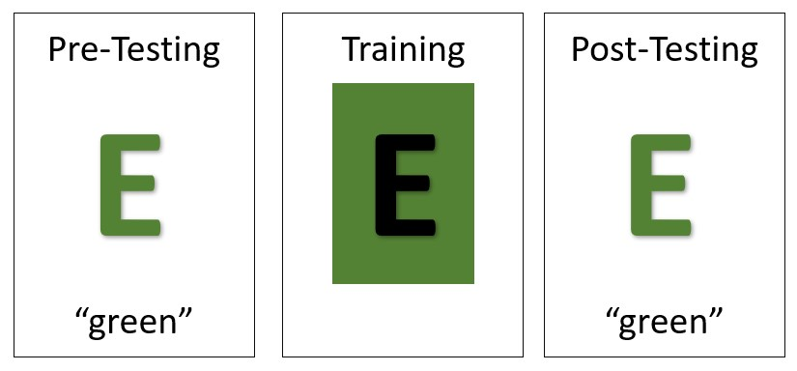
Simplified version of Bor et al. (2014)
Train people to associate colours with letters
Test success of the training with a modified Stroop task
Outcome: naming speed pre- vs post-training

Slide 23
Paired (Repeated) Design
Key difference: the same people participate in both conditions

Slide 24
A tibble: 6 × 3
id pre post 1 R7WR0Z 770. 714. 2 5DSAL8 861. 801. 3 OZJ7OP 733. 678. 4 OM0SKZ 727. 666. 5 BQT76E 361. 299. 6 1ISU5D 693. 636.
The data are paired
Both columns (pre and post) contain the same thing (here, reaction time)
Each row contains data from the same person

Slide 25
Example Output
Paired t-test data: syn_train$pre and syn_train$post t = 86.367, df = 13, p-value < 2.2e-16 alternative hypothesis: true mean difference is not equal to 0 95 percent confidence interval: 57.03669 59.96331 sample estimates: mean difference 58.5
“There was a significant difference in mean colour naming times between pre- and post-training (t(13) = 86.37, p < .001, Mdiff = 58.5, 95% CI [57.04, 59.96]).”
Causality
In our first example, could we conclude that having synaesthesia causes you to pay more attention to language?
In our second example, could we conclude that having training causes you to associate colours with letters?
. . .
Why is this?
That’s the t
The t-test quantifies the size of the difference of two means (signal) compared to the error (noise)
Independent samples t-test
Tests means from different entities/participants
Independent or “between-subjects” design
Paired samples t-test
Tests means from the same entities/participants
Repeated or “within-subjects” design
Establishing causality is a function of study design not statistics!
Have a great day!

Slide 26
Participants Needed
Hybrid teaching and disability support study: rebrand.ly/hybrid_ds
ChatGPT and AI at University study: rebrand.ly/gpt_uni
Education Award
Nominate a member of staff who has inspired or made a difference to you
Nominate for the Education Awards here!

Slide 27


